Slide 1
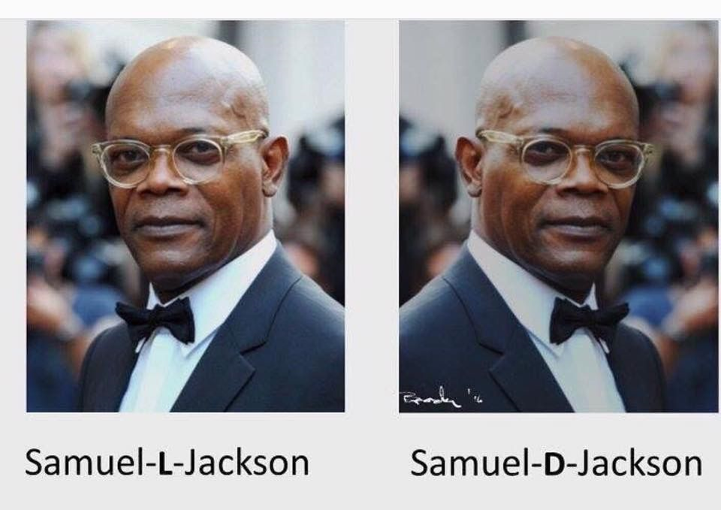
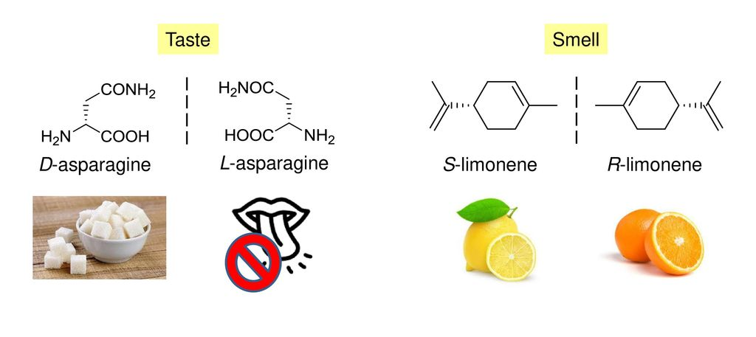
Stereochemistry (CHEM 313)
Dr. Raed Kadhim Al-Tameemi

Slide 2
Stereochemistry
Outline
1.1 Chirality—The Handedness of Molecules
1.2 Stereoisomerism How To: Draw Chiral Molecules
1.3 Naming Chiral Centers—The R,S System How To: Assign R or S Configuration to a Chiral Center
1.4 Acyclic Molecules with Two or More Stereocenters How to: Quickly Draw and Recognize Enantiomers and Diastereomers
1.5 Cyclic Molecules with Two or More Chiral Centers
1.6 Tying All the Terminology Together
1.7 Optical Activity—How Chirality Is Detected in the Laboratory
1.8 The Significance of Chirality in the Biological World
1.9 Separation of Enantiomers—Resolution

Slide 3
Stereochemistry
The study of molecules as three-dimensional objects is called stereochemistry. The ability to visualize stereochemical relationships is a survival skill in organic chemistry. The chemistry and properties of the key molecules of biochemistry are critically dependent on stereochemistry. Our goal in this chapter is to expand your awareness of molecules as three-dimensional objects. We suggest you purchase a set of models (or, if you prefer, a computer modeling program such as Spartan). Alternatively, you may have access to a computer lab with a modeling program. Use your models frequently as an aid in visualizing the spatial concepts in this chapter and in later chapters.
Stereochemistry The study of threedimensional arrangements of atoms in molecules.

Slide 4
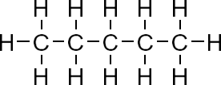
Introduction to Stereochemistry
Background
We have had the tendency to represent the bonds of the
tetravalent carbon of alkanes either as Kekule structures, condensed structures or bond-line (zigzag) structures.
Although these structures have been adequate to demonstrate the chemistry of the topics we have covered, so far, they are inadequate in describing the orientations of the bonds on a tetrahedral sp³ carbon that is 3-dimensional in nature.

Slide 5
Introduction to Stereochemistry
3D-Bond Notations Explained
The challenge of representing three dimensional systems on a two dimensional paper was resolved by the adoption
of the wedge and hash bond notation.
This bond notation should be interpreted as follows:
A bold, wedged bond represents a bond oriented towards the viewer.
A hashed bond represents a bond fading away from the viewer.
The other two line bonds are considered as being on the
plane of the paper.

Slide 6
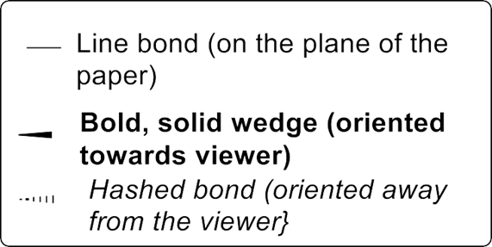
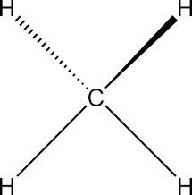
Introduction to Stereochemistry
Wedge-Hash 3D Bond Notation
For methane, the wedge-hash bond structure can be represented as shown below.
Although, the wedge-hash notation is inconsequential in the 3D structures of compounds that have similar substituents attached to a tetrahedral carbon, they are of greater significance in compounds that have four different substituents attached to carbon.

Slide 7
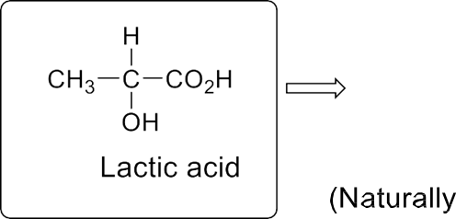
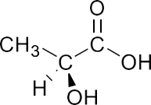
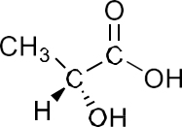
Introduction to Stereochemistry
Wedge-Hash 3D Bond Notation
For example, the partially condensed structure of lactic acid may be drawn in two wedge-hash notations.
(Naturally present in muscles) (Naturally present in sour milk)
Wedge-Hash structure Partially condensed structure wedge-Hash structure
It is worth noting that the two wedge-hash structures of lactic acid can not be interconverted by any degree of rotation along any of its single bonds. The two structures are therefore not conformers but different or distinct molecules.

Slide 8




Introduction to Stereochemistry
Stereoisomerism
It is interesting to note that the two molecules of lactic
acid have the same composition of atoms, same connectivity of atoms and only differ in the orientation of atoms in 3-dimensional space.
The two compounds are therefore isomers differing only in 3-dimensional space.
Such isomers are called stereoisomers since the prefix "stereo-" refers to the “three-dimensionality of a system”.

Slide 9
Introduction to Stereochemistry
Stereoisomerism vs Isomerism
It is important to look at how stereoisomers relate with other isomers to establish the boundaries of the relationships that will be explored in this course.
Recall that isomers have the same molecular formula (i.e., the same composition of elements).
Structural isomers have the same molecular formula but have different structural formulas (sequences of arrangements of atoms within the molecules).
Stereoisomers have the same molecular and structural formula (sequence of bonded atoms), but differ only in
the three-dimensional orientations of their atoms in space.

Slide 10
Isomers
In organic chemistry, isomers are molecules with the same molecular formula (i.e. the same number of atoms of each element), but different structural or spatial arrangements of the atoms within the molecule. Therefore, isomers are the different compounds with the same molecular formula.
On the basis of bonding connectivity (The term connectivity, or bonding sequence, describes the way atoms are connected together, or their bonding relationships to one another, in covalent compounds. For example, in the methane molecule one carbon is connected to four hydrogen atoms simultaneously, while each hydrogen atom is connected to only one carbon.), isomers are divided into two major classes: constitutional or structural isomers and stereoisomers.

Slide 11
Constitutional or Structural Isomers
Constitutional or structural isomers are compounds with the same molecular formula but different structural formulae. In isomerism, constitutional isomers are molecules of different connectivity. Therefore, constitutional isomers differ in the way the atoms are connected to each other.
Constitutional isomers have:
different IUPAC names
different bonding connectivity
the same or different functional groups
different physical properties, so they are separable by physical techniques such as distillation.
different chemical properties. They behave differently or give different products in chemical reactions.

Slide 12
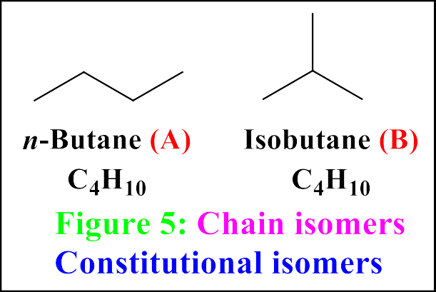
Constitutional or Structural Isomers
Structural isomers can be split again into three main subgroups: chain isomers, position isomers, and functional group isomers.
Chain isomers are molecules with the same molecular formula, but different arrangements of the carbon ‘skeleton’. Organic molecules are based on chains of carbon atoms, and for many molecules this chain can be arranged differently (Figure 5): either as one, continuous chain, or as a chain with multiple side groups of carbons branching off.
For example, there are two isomers of butane, C₄H₁₀. In one of them (A), the carbon atoms lie in a “straight chain” whereas in the other (B) the chain is branched.

Slide 13
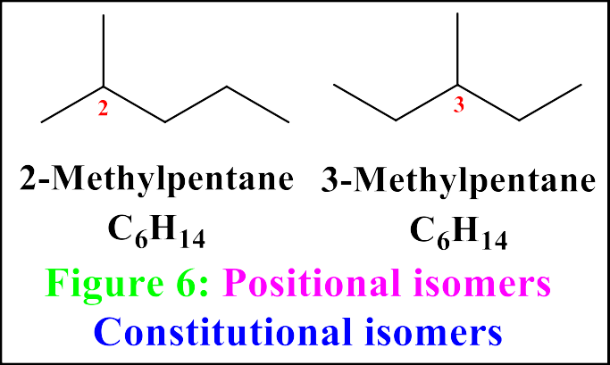
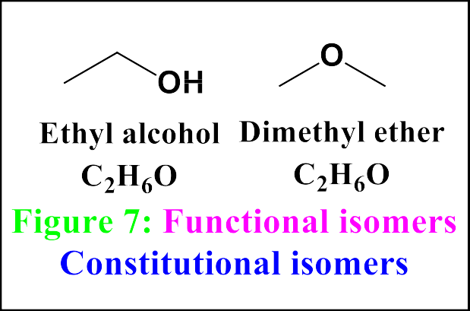
Constitutional or Structural Isomers
Positional isomers are constitutional isomers that have the same carbon skeleton and the same functional groups but differ from each other in the location of the functional groups on or in the carbon chain (Figure 6).
Functional isomerism occurs when substances have the same molecular formula but different functional groups. This means that functional isomers belong to different homologous series. They can be alcohols and ethers; aldehydes and ketones; carboxylic acids and esters, etc.
This Lecture is prepared by Dr. K. K. Mandal, SPCMC, Kolkata

Slide 14
Stereoisomers
In stereochemistry, stereoisomerism, or spatial isomerism, is a form of isomerism in which molecules have the same molecular formula and sequence of bonded atoms (bonding connectivity), but differ in the three-dimensional orientations of their atoms in space. This contrasts with structural isomers, which share the same molecular formula, but the bond connections or their order differs.
Stereoisomers have identical IUPAC names (except for a prefix like cis or trans). Because they differ only in the three-dimensional arrangement of atoms, stereoisomers always have the same functional group(s).
There are two main types of stereoisomerism-geometric isomerism, and optical isomerism.

Slide 15
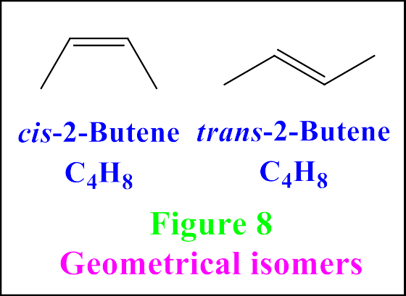
Geometrical Isomers
Stereoisomerism ascribed to different directional arrangements of specifically located groups in the molecule and usually considered to be caused by prevention of free rotation in parts of the molecule (as by a double bond or a ring).
This type of isomerism most frequently involves in compounds containing carbon-carbon double bonds with suitable substituents. Rotation of these bonds is restricted, compared to single bonds, which can rotate freely.
This means that, if there are two different atoms, or groups of atoms, attached to each carbon of the carbon carbon double bond, they can be arranged in different ways to give different molecules (Figure 8).

Slide 16
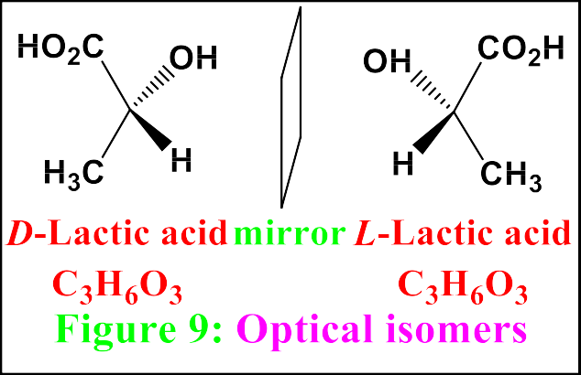
Optical Isomers
Optical isomers are two compounds which contain the same number and kinds of atoms, and bonds (i.e., the connectivity between atoms is the same), and different spatial arrangements of the atoms, but which have non-superimposable mirror images. Each non-superimposable mirror image structure is called an enantiomer.
Optical isomers are so named due to their effect on plane-polarised light, and come in pairs. They usually (although not always) contain a chiral centre – this is a carbon atom, with four different atoms (or groups of atoms) attached to it.
These atoms or groups can be arranged differently around the central carbon, in such a way that the molecule can’t be rotated to make the two arrangements align (Figure 9).

Slide 17








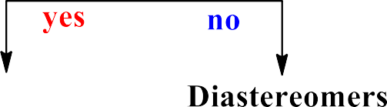






Classification of Isomers

Slide 18
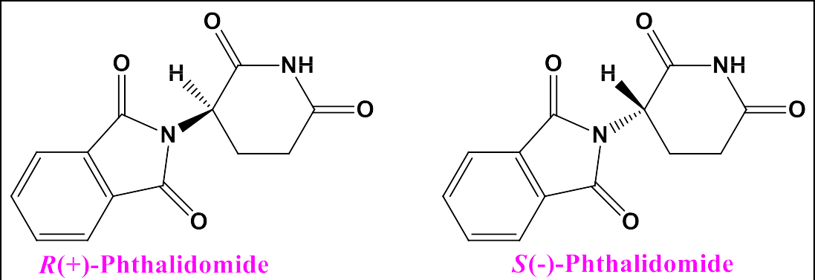
The Importance of Isomerism
Isomers of the same molecule have the potential to have different physical or chemical properties. These differences can have some important implications.
Thalidomide (Figure below), a drug was prescribed in the 1950s and 60s to treat morning sickness in pregnant women; however, unknown then was that the (S)-enantiomer could be transformed in the body into compounds that caused deformities in embryos. The two enantiomers also interconvert in the body, meaning that even if just the (R)-enantiomer could be isolated, it would still produce the same effects.
This emphasised the importance of testing all of the optical isomers of drugs for effects, and is part of the reason why present-day pharmaceuticals have to go through years of rigorous tests, to ensure that they are safe.
Optical isomers of phthalidomide

Slide 19
Examples of Stereoisomers

Slide 20
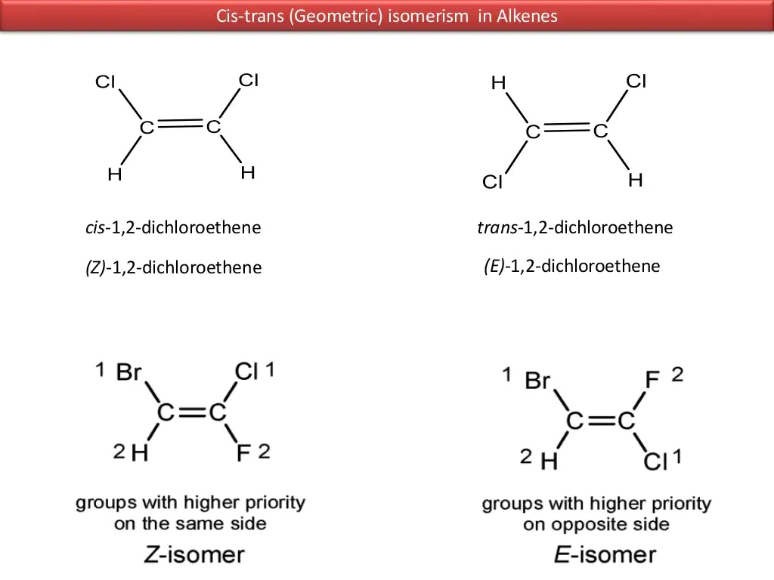
Examples of Stereoisomers

Slide 21
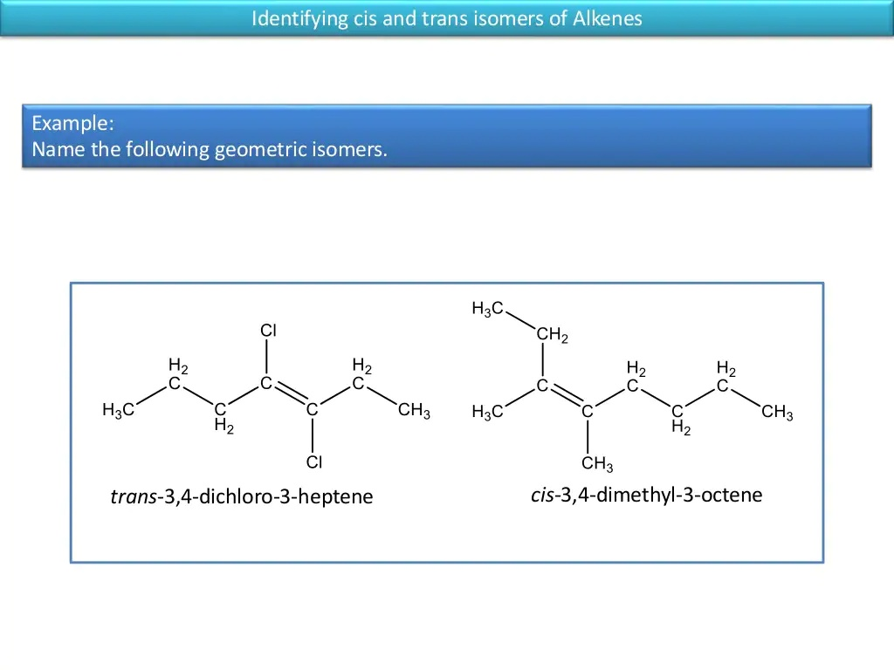
Examples of Stereoisomers

Slide 22
Chiral Molecules and Chiral samples
What is the difference between your left hand and your right hand? They look similar, yet a left-handed glove does not fit the right hand. The same principle applies to your feet. They look almost identical, yet the left shoe fits painfully on the right foot. The relationship between your two hands or your two feet is that they are nonsuperimposable (nonidentical) mirror images of each other. Objects that have left-handed and right-handed forms are called chiral (ki′rel, rhymes with “spiral”), the Greek word for “handed.” We can tell whether an object is chiral by looking at its mirror image (Figure 1). Every physical object (with the possible exception of a vampire) has a mirror image, but a chiral object has a mirror image that is different from the original object. For example, a chair and a spoon and a glass of water all look the same in a mirror. Such objects are called achiral, meaning “not chiral.” A hand looks different in the mirror. If the original hand were the right hand, it would look like a left hand in the mirror.

Slide 23
Chiral Molecules and Chiral samples
Besides shoes and gloves, we encounter many other chiral objects every day (Figure 2). What is the difference between an English car and an American car? The English car has the steering wheel on the right-hand side, while the American car has it on the left. To a first approximation, the English and American cars are nonsuperimposable mirror images. Most screws have right-hand threads and are turned clockwise to tighten. The mirror image of a right-handed screw is a left-handed screw, turned counterclockwise to tighten. Those of us who are left-handed realize that scissors are chiral. Most scissors are right-handed. If you use them in your left hand, they cut poorly, if at all. A left-handed person must go to a well-stocked store (or a specialized “Leftorium”) to find a pair of left-handed scissors, the mirror image of the “standard” right-handed scissors.

Slide 24
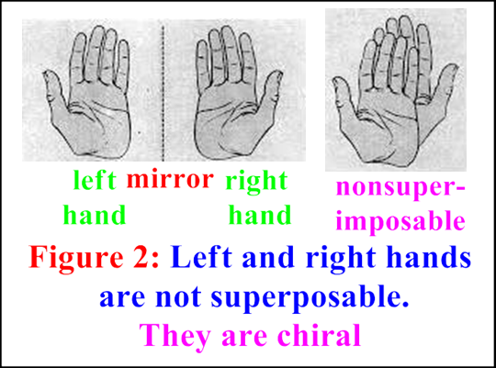
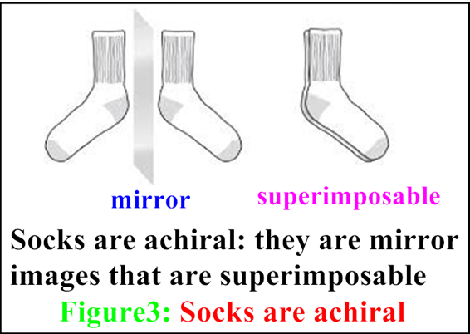
Chiral Molecules and Chiral samples
What’s important in chemistry is whether a molecule is identical to or different from its mirror image. Some molecules are like hands. Left and right hands are mirror images of each other, but they are not identical (Figure 2). If one hand is placed on the other, they can never superimpose either all the fingers, or the tops and palms. Socks, on the contrary, are superposable to each other (Figure 2).
To superimpose an object on its mirror image means to align all parts of the object with its mirror image. With molecules, this means aligning all atoms and all bonds.
A molecule (or object) that is not superimposable on its mirror image is said to be chiral.

Slide 25
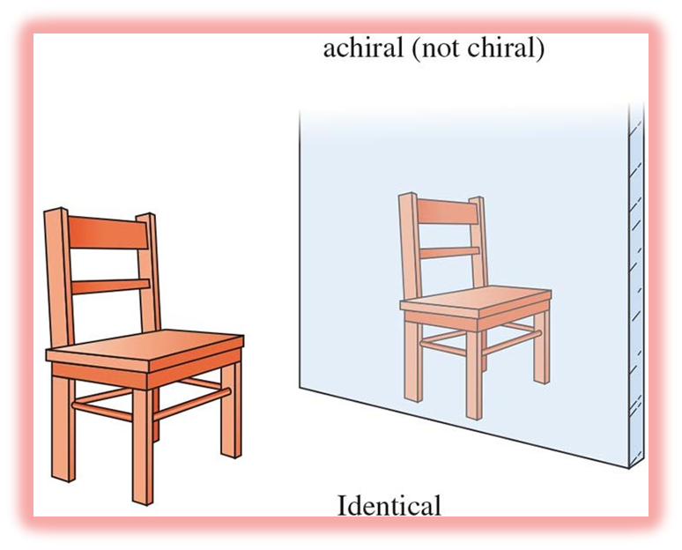
Chiral and Achiral Molecules
Other molecules are like socks. Two socks from a pair are mirror images that are superimposable. One sock can fit inside another. A sock and its mirror image are identical.
A molecule (or object) that is superimposable on its mirror image is
said to be achiral.
Answer the Following Questions
There are twenty-six letters in English language. How many of them are symmetric and how many of them are non-symmetric, considering them as two-dimensional.
Classify the following as chiral or achiral. Give reasons.
H₂O (ii) CH₂BrCl (iii) CHBrClF

Slide 26
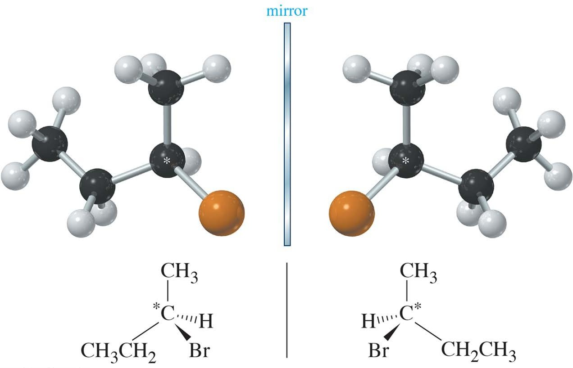
Asymmetric Carbon Atoms, Chiral Centers, and Stereocenters
The three-dimensional drawing of 2-bromobutane in Figure below shows that 2-bromobutane cannot be superimposed on its mirror image. This simple molecule is chiral, with two distinct enantiomers. What is it about a molecule that makes it chiral? The most common feature (but not the only one) that leads to chirality is a carbon atom that is bonded to four different groups. Such a carbon atom is called an asymmetric carbon atom or a chiral carbon atom, and is often designated by an asterisk (*).

Slide 27
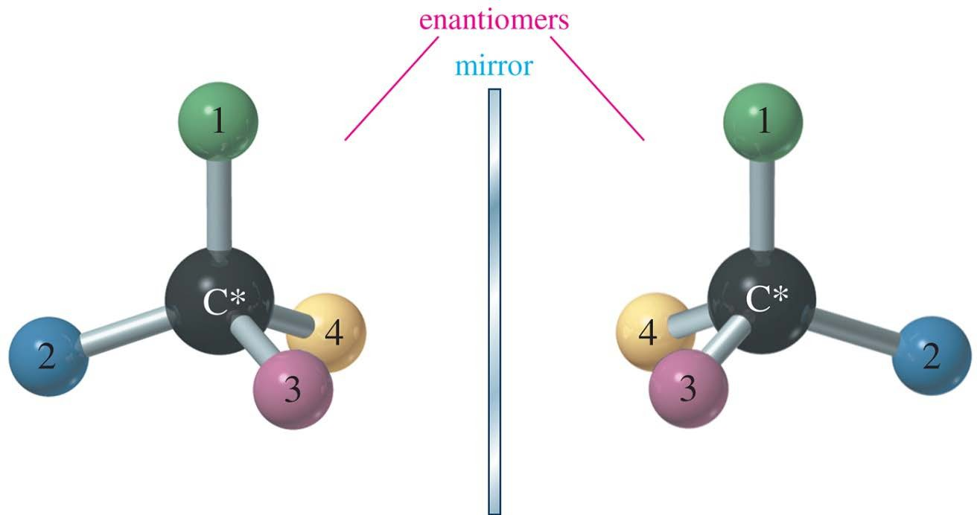
Chiral Carbon Atom
Also called asymmetric carbon atom
A carbon atom that is bonded to four different groups is chiral.
Its mirror image will be a different compound (enantiomer).
Enantiomers are mirror images that are not superimposable.

Slide 28
Stereocenters
An asymmetric carbon atom is the most common example of a chirality center.
Chirality centers belong to an even broader group called stereocenters. A stereocenter (or stereogenic atom) is any atom at which the interchange of two groups gives a stereoisomer.
Asymmetric carbons and the double-bonded carbon atoms in cis-trans isomers are the most common types of stereocenters.

Slide 29
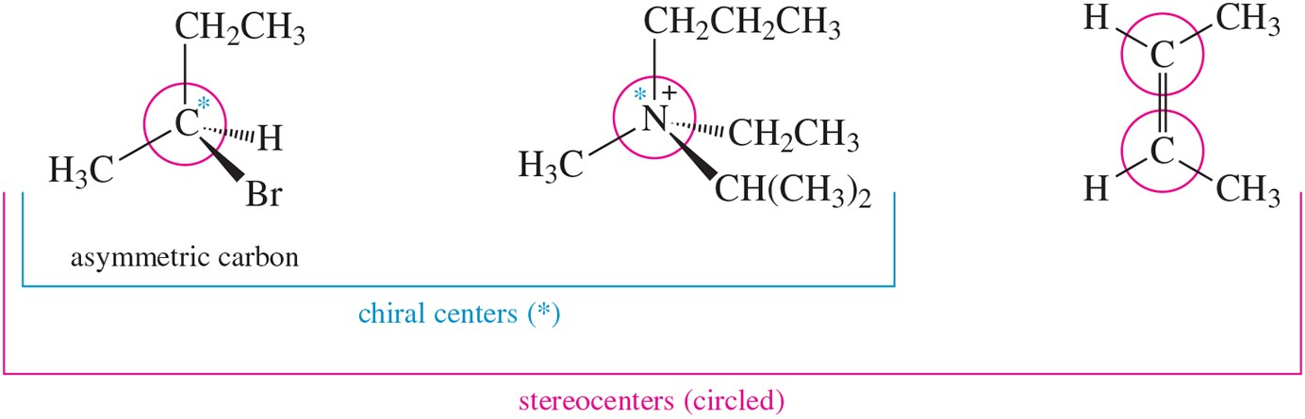
Examples of Chirality Centers
Asymmetric carbon atoms are examples of chirality centers, which are examples of stereocenters.

Slide 30
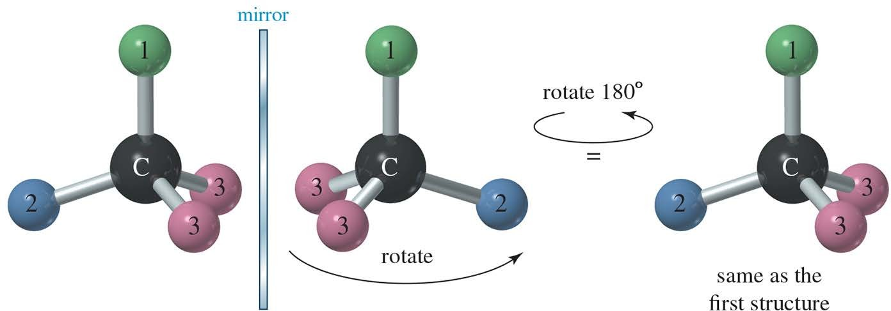
Achiral Compounds
Take this mirror image and try to superimpose it on the one to the left matching all the atoms. Everything will match.
When the images can be superposed, the compound is achiral.

Slide 31
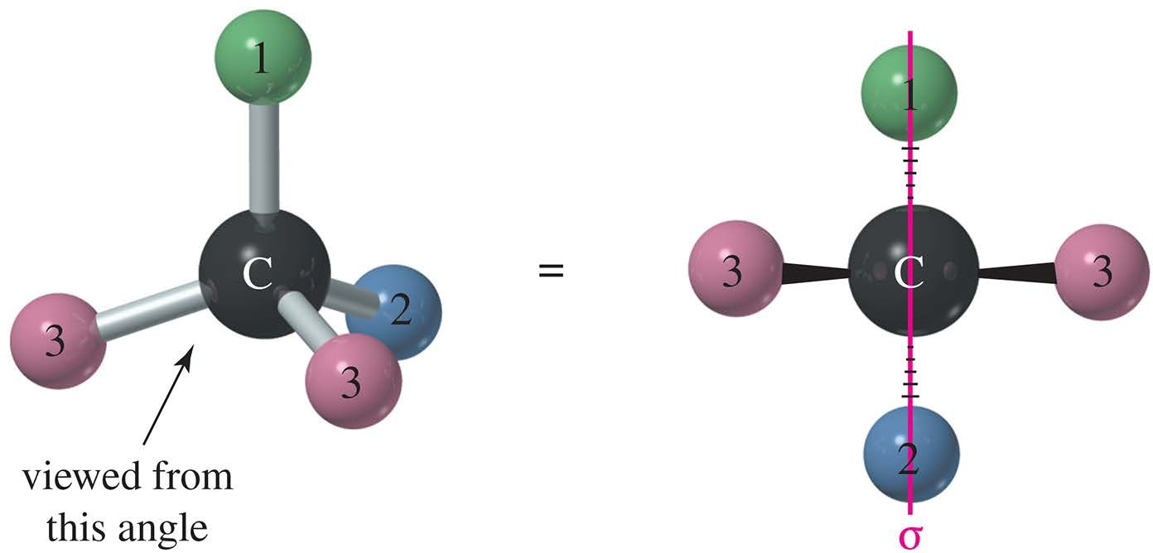
Planes of Symmetry
A molecule that has a plane of symmetry is achiral.

Slide 32
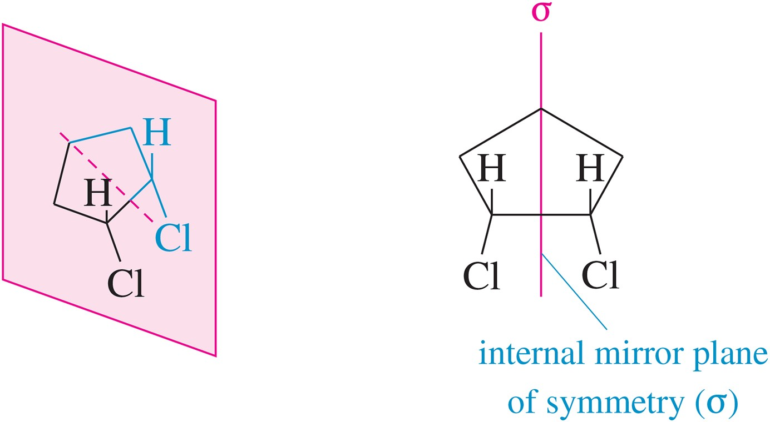
Cis Cyclic Compounds
Cis-1,2-dichlorocyclohexane is achiral because the molecule has an internal plane of symmetry. Both structures above can be superimposed.

Slide 33
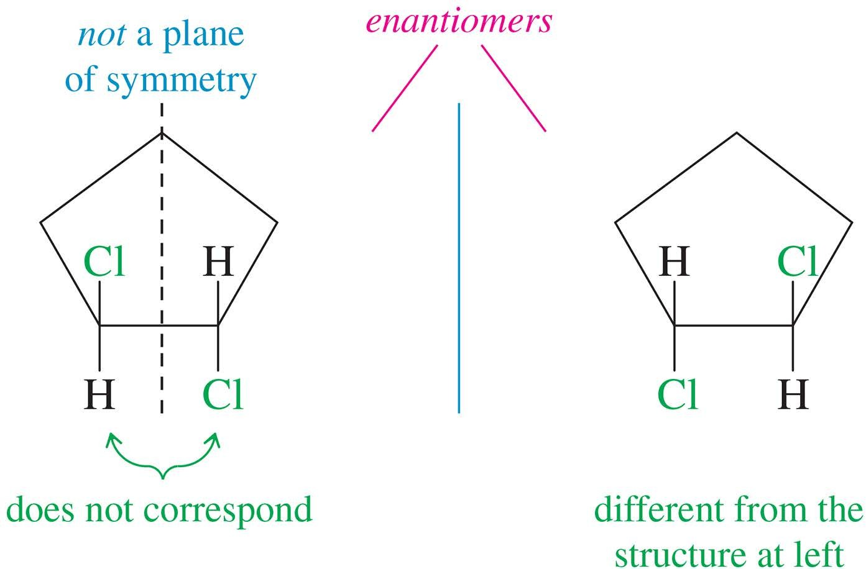
Trans Cyclic Compounds
Trans-1,2-dichlorocyclohexane does not have a plane of symmetry, so the images are nonsuperimposable and the molecule will have two enantiomers.

Slide 35
Draw chiral molecule

Slide 36
Solved problem

Slide 37
Problems

Slide 38
Drawing a Pair of Enantiomers
• Any molecule with one tetrahedral stereogenic center is a chiral compound and exists as a pair of enantiomers. Butan-2-ol, for example, has one stereogenic center. To draw both enantiomers, use the typical convention for depicting a tetrahedron: place two bonds in the plane, one in front of the plane on a wedge, and one behind the plane on a dashed wedge. Then, to form the first enantiomer A, arbitrarily place the four groups—H, OH, CH₃, and CH₂CH₃—on any bond to the stereogenic center.
Then, draw a mirror plane and arrange the substituents in the mirror image so that they are a reflection of the groups in the first molecule, forming B. No matter how A and B are rotated, it is impossible to align all of their atoms. Because A and B are mirror images and not superimposable, A and B are a pair of enantiomers.

Slide 39
Drawing a Pair of Enantiomers

Slide 40
Drawing a Pair of Enantiomers

Slide 41
Configuration of Stereocenters Naming Chiral Centers—The R,S System
Because enantiomers are two different compounds, we need a method to distinguish them by name. This is done by adding the prefix R or S to the IUPAC name of the enantiomer. To designate an enantiomer as R or S, first assign a priority (1, 2, 3, or 4) to each group bonded to the stereogenic center, and then use these priorities to label one enantiomer R and one S.
Experimental determination of absolute configuration can be accomplished by using x-ray analysis of a derivative that has a chiral center with a known absolute configuration. In biological molecules, many absolute configurations were determined by comparison to absolute configurations of the chiral center in glyceraldehyde. A system for designating the absolute configuration of a chiral center was devised in the late 1950s by R. S. Cahn and C. K. Ingold in England and V. Prelog in Switzerland and is named after them. The system, also called the R,S system, has been incorporated into the IUPAC rules of nomenclature. The orientation of groups about a chiral center is specified using a set of priority rules.

Slide 42
Configuration of Stereocenters Rules Needed to Assign Priority
Rule 1 Assign priorities (1, 2, 3, or 4) to the atoms directly bonded to the stereogenic center in order of decreasing atomic number. The atom of highest atomic number gets the highest priority (1).
In CHBrClF, priorities are assigned as follows: Br (1, highest) → Cl (2) → F (3) → H (4, lowest). In many molecules the lowest priority group will be H.

Slide 43
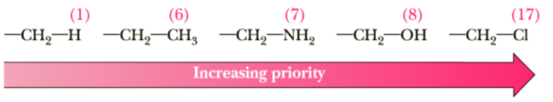
Configuration of Stereocenters
Rule 2 If two atoms on a stereogenic center are the same, assign priority based on the atomic number of the atoms bonded to these atoms. One atom of higher atomic number determines a higher priority.
With butan-2-ol, the O atom gets highest priority (1) and H gets lowest priority (4) using Rule 1. Butan-2-ol also has two carbon atoms bonded to the stereogenic center, one that is part of a CH₃ group and one that is part of a CH₂CH₃ group. To assign priority (either 2 or 3) to the two C atoms, look at what atoms (other than the stereogenic center) are bonded to each C.

Slide 44
Configuration of Stereocenters
• The CH₂CH₃ gets higher priority (2) than the CH₃ group (priority 3) because the carbon of the ethyl group is bonded to another carbon.
• The order of priority of groups in butan-2-ol is -OH (1), -CH₂CH₃ (2), -CH₃ (3), and -H (4).
• If priority still cannot be assigned, continue along a chain until a point of difference is reached
Rule 3 If two isotopes are bonded to the stereogenic center, assign priorities in order of decreasing mass number.
• In comparing two isotopes of the element hydrogen, deuterium, which has a mass number of two (one proton and one neutron), has a higher priority than hydrogen, which has a mass number of one (one proton only).

Slide 45
Configuration of Stereocenters
Rule 4 To assign a priority to an atom that is part of a multiple bond, treat a multiply bonded atom as an equivalent number of singly bonded atoms.

Slide 46
Problems

Slide 48
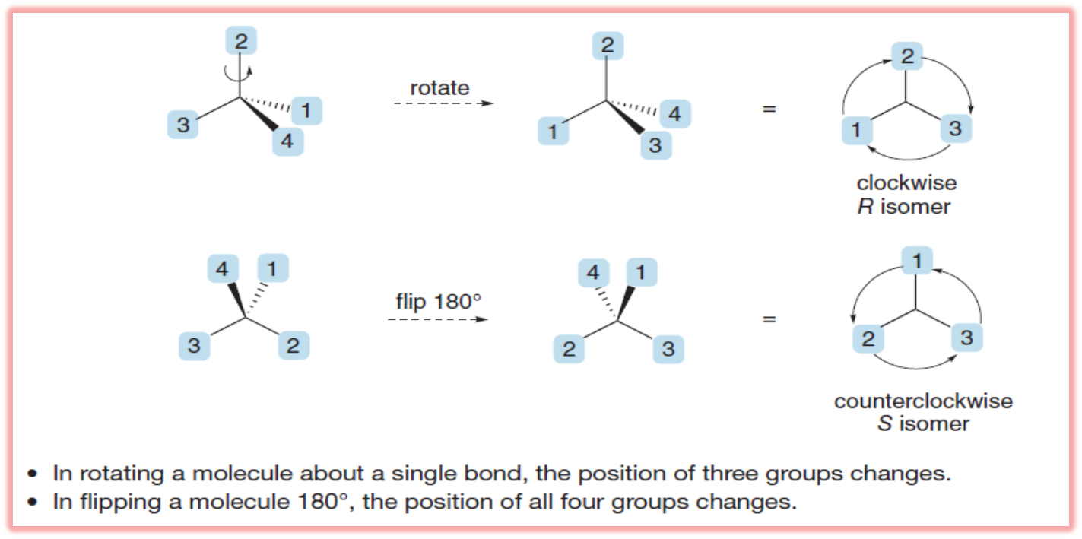
How do you assign R or S to a molecule when the lowest priority group is not oriented toward the back, on a dashed wedge? You could rotate and flip the molecule until the lowest priority group is in the back, as shown in Figure below; then follow the stepwise procedure for assigning the configuration. Or, if manipulating and visualizing molecules in three dimensions is difficult for you, try the procedure suggested in Sample Problem in the next slide.

Slide 51
Solved Problem

Slide 52
Solved Problem

Slide 54
Molecules with multiple stereocenters
Molecules w ith 1 stereocenter can be R or S
2 possible
stereoisomers
Molecules w ith n stereocenters can have all the possible
combinations of R and S for each stereocenter
2^{n} possible
stereoisomers

Slide 55
Enantiomers and Diastereomers with two or more stereocentres
We have now seen several examples of molecules with one chiral center and verified that, for each, two stereoisomers (one pair of enantiomers) are possible. Now let us consider molecules with two or more chiral centers. To generalize, for a molecule with n chiral centers, the maximum number of stereoisomers possible is 2^{n}. We have already seen that, for a molecule with one chiral center, 2¹ = 2 stereoisomers are possible. For a molecule with two chiral centers, 2² = 4 stereoisomers are possible; for a molecule with three chiral centers, 2³ = 8 stereoisomers are possible; and so forth. Let us begin our study of molecules with multiple chiral centers by considering 2,3,4-trihydroxybutanal, a molecule with two chiral centers, shown here highlighted.

Slide 56
Enantiomers and Diastereomers with two or more stereocentres
The maximum number of stereoisomers possible for 2,3,4-trihydroxybutanal is 2² = 4, each of which is drawn in Figure below. One of these pairs is called erythrose; the other, threose. Stereoisomers (a) and (b) are nonsuperposable mirror images and are, therefore, a pair of enantiomers. Stereoisomers (c) and (d) are also nonsuperposable mirror images and are a second pair of enantiomers. One way to describe the four stereoisomers of 2,3,4-trihydroxybutanal is to say that they consist of two pairs of enantiomers. Enantiomers (a) and (b) of 2,3,4-trihydroxybutanal are given the names (2R,3R)- erythrose and (2S,3S)-erythrose; enantiomers (c) and (d) are given the names (2R,3S)-threose and (2S,3R)-threose. Note that all of the chiral centers in a molecule are reversed in its enantiomer. The molecule with the 2R,3S configuration is the enantiomer of the molecule with 2S,3R, and the molecule with 2S,3S is the enantiomer of the molecule with 2R,3R. Erythrose and threose belong to the class of compounds called carbohydrates. Erythrose is found in erythrocytes (red blood cells), hence the derivation of its name. We have specified the relationship between (a) and (b) and between (c) and (d); each represents a pair of enantiomers. What is the relationship between (a) and (c), between (a) and (d), between (b) and (c), and between (b) and (d)? The answer is that they are diastereomers. Recall that diastereomers are stereoisomers that are not mirror images (enantiomers). As we see in this example, molecules with at least two chiral centers can have diastereomers.

Slide 57
Enantiomers and Diastereomers with two or more stereocentres

Slide 58


Tartaric Acid
HO
*
CO₂H
4 possible
stereoisomers
2 stereocenters
*
HO
CO H
2
Mirror
H
H
D
i a s t e r
HO
CO₂H
Enantiomers
HO₂C
OH
D
i a s t e r
S S
R R
HO
CO₂H
D _{ia}
_{a s} t
HO₂C
OH
H H
s _{t D} i
H
H
o
HO
CO₂H
HO C
OH
m e r s
R S
2
o
?
S R
m e r s
HO
CO H
2
HO₂C
OH
H
H

Slide 59
Remember
Enantiomers : stereoisomers that are non superposable mirror images.
Diastereomers : stereoisomers that are not mirror images.
For example:
H H
not mirror image
HO CO₂H
HO₂C
OH
S S
S R
mirror image
HO CO₂H
HO₂C OH
H
H
(S, S)-Tartaric acid (S, R)-Tartaric acid
DIASTEREOMERS

Slide 62
H
mirror image
H
HO
CO₂H
HO₂C
OH
R
S
S
mirror image
R
HO
CO₂H
HO₂C
OH
H
H
(R, S)-Tartaric acid (S, R)-Tartaric acid
Enantiomers
?

Slide 63
Why not Enantiomers?
H
H
CO₂H HO₂C
HO
OH
R S
S R
Same
compound!!!!
HO CO₂H
HO₂C
OH
H
H
Enantiomers:
√ same molecular formula
√ same connectivity
√ mirror images
X nonsuperposable
Superposable
Achiral compound

Slide 64
Why not Enantiomers?
H
Plane of symmetry
H
HO
CO₂H
HO₂C
OH
R
S
S
Same
compound!!!!
R
HO
CO₂H
HO₂C
OH
H
H
Meso compound
A compound with at least 2 stereocenters that is achiral due to the presence of a plane of symmetry

Slide 67



Properties of Stereoisomers
Enantiomers : have same chemical and physical properties in an achiral
environment but they differ on the sign
of rotation of plane polarized light.
For example: Enantiomers of Epinephrine (Adrenaline)
CH₃ CH₃
N N
H H
H
H
R
S
HO
OH
[α]_{D}= + 53.3º
H
H
[α]_{D}= - 53.3 º
OH
HO
OH OH
Same melting/boiling point, same rate of reaction w ith achiral reagents, same degree of rotation of plane
polarized light………thus difficult to separate!

Slide 68


Properties of Stereoisomers
Carvone exists as
a pair of enantiomers:
O
O
H
S
R
H
(+)-carvone
smells like cara w ay
[α]_{D} = + 62.5
(-)-carvone
smells like spearmint
[α]_{D}= − 62.5
Note:
No relationship exists bet w een the S/R configuration and the sign or the magnitude of rotation of plane
polarized light.
A 1:1 mixture of enantiomers ( racemic mixture ) has
alw ays no optical activity ( rotation equal to zero ) because the rotation of 50% of one enantiomer is
cancelled out by the rotation ( equal but opposite) of 50% of the other enantiomer.

Slide 69

Properties of Stereoisomers
Diastereomers : have different chemical and physical properties in any type of
environment.
H H
HO CO₂H HO₂C
S S
OH
S R
HO CO₂H HO₂C
OH
H
H
(S,S)-Tartaric Acid
- 12.7
Mesotartaric Acid
0 (achiral) 146-148
1.660
125
[α]_{D}
Melting p. ( º C) Density (g/cm ³)
Solubility in H ₂O
171-174
1.7598
139

Slide 70
Fischer Projection
We have been using dashed lines and wedges to indicate perspective in drawing the stereochemistry of asymmetric carbon atoms. When we draw molecules with several asymmetric carbons, perspective drawings become time-consuming and cumbersome. In addition, the complicated drawings make it difficult to see the similarities and differences in groups of stereoisomers. At the turn of the 20th century, Emil Fischer was studying the stereochemistry of sugars, which contain as many as seven asymmetric carbon atoms. To draw these structures in perspective would have been difficult, and to pick out minor stereochemical differences in the drawings would have been nearly impossible. Fischer developed a symbolic way of drawing asymmetric carbon atoms, allowing them to be drawn rapidly. The Fischer projection also facilitates comparison of stereoisomers, holding them in their most symmetric conformation and emphasizing any differences in stereochemistry. We learn to use Fischer projections because they clarify stereochemical differences and allow fast and accurate comparison of structures.

Slide 71
Drawing Fischer Projections
The Fischer projection looks like a cross, with the asymmetric carbon (usually not drawn in) at the point where the lines cross. The horizontal lines are taken to be wedges—that is, bonds that project out toward the viewer. The vertical lines are taken to project away from the viewer, as dashed lines. Figure below shows the perspective implied by the Fischer projection. The center drawing, with the wedged horizontal bonds looking like a bow tie, illustrates why this projection is sometimes called the “bow-tie convention.” Problem next slide should help you to visualize how the Fischer projection is used.

Slide 72
Solved Problem

Slide 73
Solved Problem
In working the previous problem, you may have noticed that Fischer projections that differ by a 180° rotation are the same. When we rotate a Fischer projection by 180°, the vertical (dashed line) bonds still end up vertical, and the horizontal (wedged) lines still end up horizontal. The “horizontal lines forward, vertical lines back” convention is maintained.

Slide 74
Solved Problem
On the other hand, if we were to rotate a Fischer projection by 90°, we would change the configuration and confuse the viewer. The original projection has the vertical groups back (dashed lines) and the horizontal groups forward. When we rotate the projection by 90°, the vertical bonds become horizontal and the horizontal bonds become vertical. The viewer assumes that the horizontal bonds come forward and that the vertical bonds go back. The viewer sees a different molecule (actually, the enantiomer of the original molecule).

Slide 75
Drawing Fisher Projection
In comparing Fischer projections, we cannot rotate them by 90°, and we cannot flip them over. Either of these operations gives an incorrect representation of the molecule. The Fischer projection must be kept in the plane of the paper, and it may be rotated only by 180°. The final rule for drawing Fischer projections helps to ensure that we do not rotate the drawing by 90°. This rule is that the carbon chain is drawn along the vertical line of the Fischer projection, usually with the IUPAC numbering from top to bottom. In most cases, this numbering places the most highly oxidized carbon substituent at the top. For example, to represent (R)-propane-1,2-diol with a Fischer projection, we should arrange the three carbon atoms along the vertical. C1 is placed at the top, and C3 at the bottom.

Slide 76
Problems

Slide 77
Drawing Mirror Images of Fischer Projections
How should we draw the mirror image of a molecule drawn in Fischer projection? With our perspective drawings, the rule was to reverse left and right while keeping the other directions (up and down, front and back) in their same positions. This rule still applies to Fischer projections. Interchanging the groups on the horizontal part of the cross reverses left and right while leaving the other directions unchanged. Testing for enantiomerism is particularly simple using Fischer projections. If the Fischer projections are properly drawn (carbon chain along the vertical), and if the mirror image cannot be made to look the same as the original structure with a 180° rotation in the plane of the paper, the two mirror images are enantiomers. In the following examples, any groups that fail to superimpose after a 180° rotation are circled in red.

Slide 78
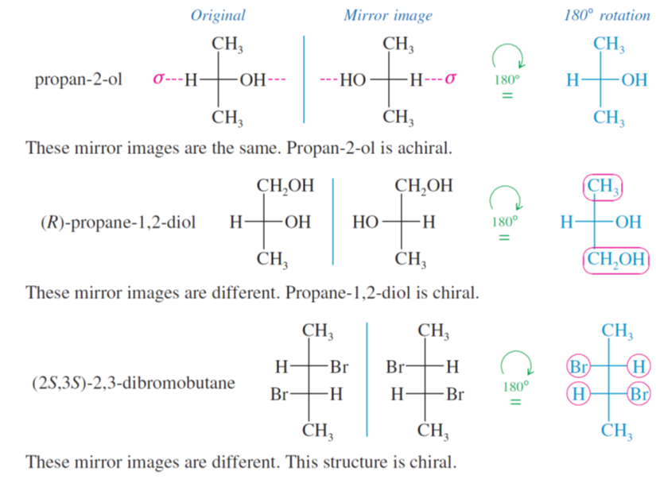
Drawing Mirror Images of Fischer Projections

Slide 79
Drawing Mirror Images of Fischer Projections
Mirror planes of symmetry are particularly easy to identify from the Fischer projection because this projection is normally the most symmetric conformation. In the first preceding example (propan-2-ol) and in the following example [(2S,3R)-2,3-dibromobutane], the symmetry planes are indicated in red; these molecules with symmetry

Slide 80
Problems

Slide 81
Assigning (R) and (S) Configurations from Fischer Projections
The Cahn−Ingold−Prelog convention can be applied to structures drawn using Fischer projections. Let’s review the two rules for assigning (R) and (S): (1) Assign priorities to the groups bonded to the asymmetric carbon atom; (2) put the lowest-priority group (usually H) in back, and draw an arrow from group 1 to group 2 to group 3. Clockwise is (R), and counterclockwise is (S). The (R) or (S) configuration can also be determined directly from the Fischer projection, without having to convert it to a perspective drawing. The lowest-priority atom is usually hydrogen. In the Fischer projection, the carbon chain is along the vertical line, so the hydrogen atom is usually on the horizontal line and projects out in front. Once we have assigned priorities, we can draw an arrow from group 1 to group 2 to group 3 and see which way it goes. If the molecule were turned around so that the hydrogen would be in back [as in the definition of (R) and (S)], the arrow would rotate in the other direction. By mentally turning the arrow around (or simply applying the rule backward), we can assign the configuration.

Slide 82
Assigning (R) and (S) Configurations from Fischer Projections
As an example, consider the Fischer projection formula of one of the enantiomers of glyceraldehyde. First priority goes to the ¬OH group, followed by the ¬CHO group and the ¬CH₂OH group. The hydrogen atom receives the lowest priority. The arrow from group 1 to group 2 to group 3 appears counterclockwise in the Fischer projection. If the molecule is turned over so that the hydrogen is in back, the arrow becomes clockwise, making this the (R) enantiomer of glyceraldehyde

Slide 83
Problems

Slide 84

Summary
SUMMARY Fischer Projections and Their Use
1. They are most useful for compounds with two or more asymmetric carbon atoms.
2. Asymmetric carbons are at the centers of crosses.
3. The vertical lines project away from the viewer; the horizontal lines project toward the viewer (like a bow tie ).
4. The carbon chain is placed along the vertical, with the IUPAC numbering from top to bottom. In most cases, this places the more oxidized end (the carbon with the most bonds to O or halogen) at the top.
5. The entire projection can be rotated 180° (but not 90°) in the plane of the paper without changing its stereochemistry.
6. Interchanging any two groups on an asymmetric carbon (for example, those on the horizontal line) inverts its stereochemistry.

